Slide 1
SkillCourt 4.0 Team Member(s): Sebastien Dolce Luis Puche Product Owner(s): Gummi Traustason Jaime Borras Instructor: Masoud Sadjadi School of Computing and Information Sciences Florida International University
Senior Project Final Presentation Spring 2016
03/07/2016
Notes:
Greet your audience, thank them for attending your presentation, introduce yourself, introduce your project, introduce your team members, and quickly indicate what each of you did in a high-level manner, and put more emphasis on your part/contribution.

Slide 2
What is SkillCourt
Whole Project:
SkillCourt is an interactive athletic training system that uses illuminated target pads. The SkillCourt pads include touch and pressure sensors which report ball activity to the SkillCourt app.
My Part:
An implementation on android OS exists for this project. My main focus is on an iOS implementation. The goal is to port all implementation to ios and add new features according to specifications
Notes:
Introduce the problem that the whole project tackles and stay focused on the parts that you have been working. Indicate if there is an existing previous system, enumerate its problems/limitations, etc.

Slide 3
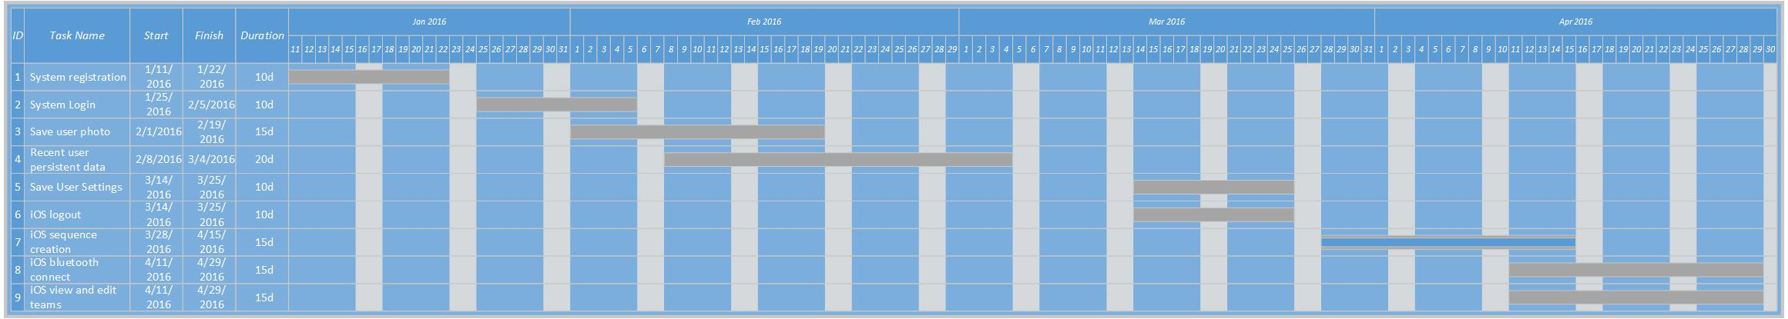
Project Management
Notes:
Project Management (schedule for entire semester) (one slide; Gantt Chart).

Slide 4
Requirements: User Stories
System Registration
Setup project
Setup CoreData
Setup Parse Database
System Login
Integrate CoreData
Create all necessary views
Prepare property lists
iOS view and edit teams
User photo
Configure database
Create image data representation
Reduce image size (parse restrictions)
Recent user persistent data
Configure CoreData relationships
Set CoreData security
iOS bluetooth
Notes:
4. Requirements:
4.1. User stories implemented (one or more slides).
4.2. UML use cases and the use case diagram for the implemented use cases (one or more slides).
4.3. UML sequence diagrams for the implemented use cases.

Slide 5
Requirements: User Stories
Recent user persistent data
As a user I would like to save data on the device so that I can access it offline
Configure CoreData relationships
Setup CoreData model
Setup relationships
Set CoreData security
Set a private key for the persistent data security

Slide 6
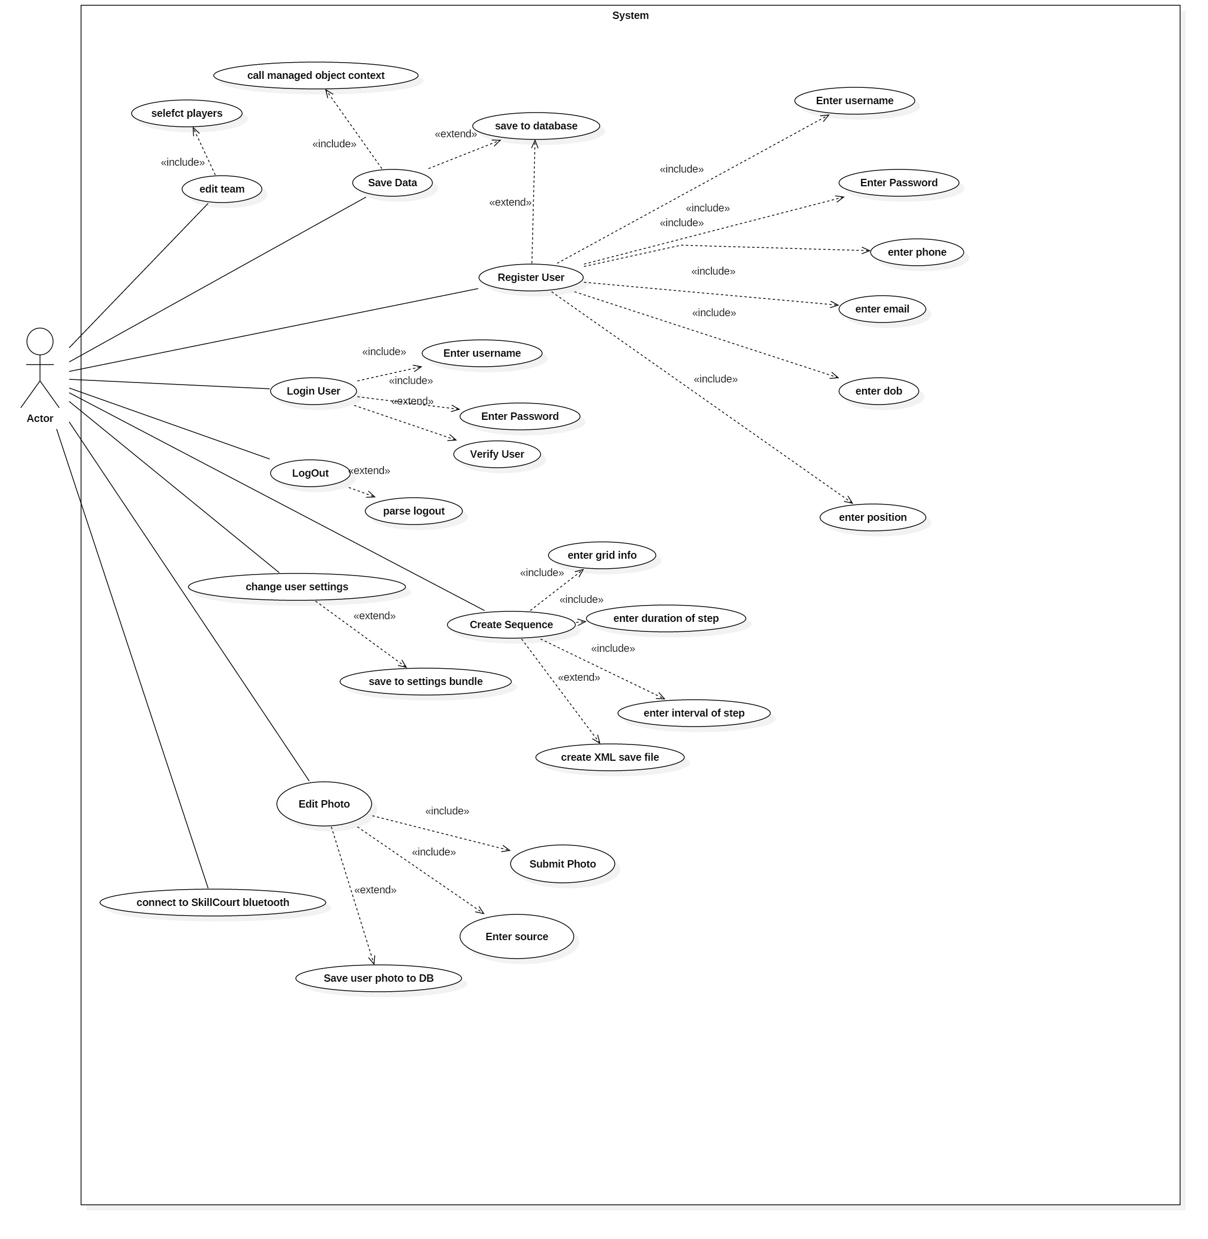
Requirements: Use Cases
Notes:
4. Requirements:
4.1. User stories implemented (one or more slides).
4.2. UML use cases and the use case diagram for the implemented use cases (one or more slides).
4.3. UML sequence diagrams for the implemented use cases.

Slide 7
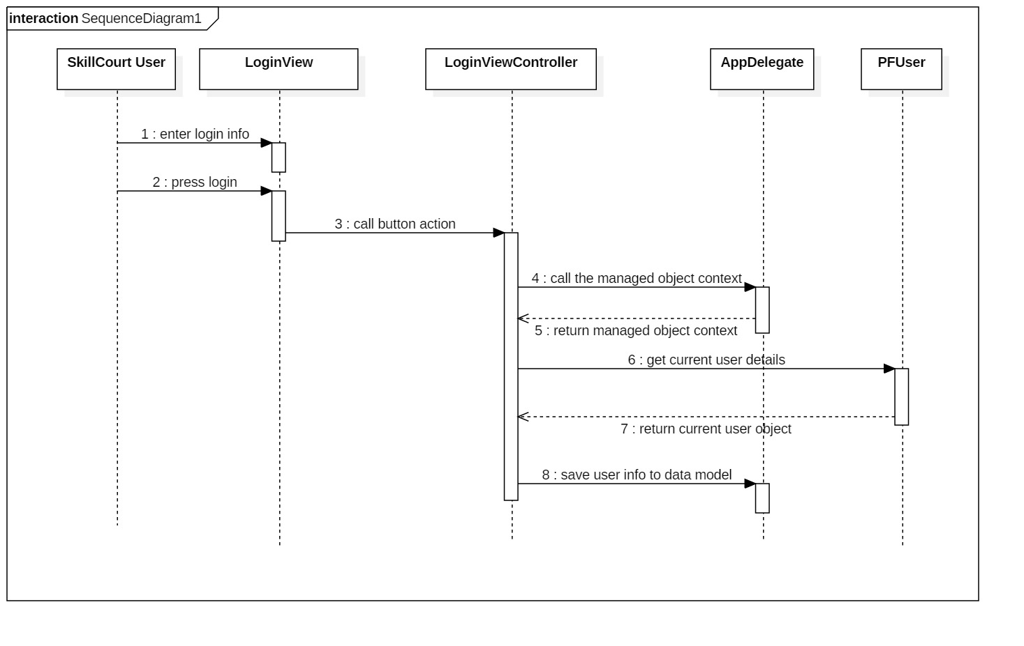
Requirements: Sequence Diagrams
Notes:
4. Requirements:
4.1. User stories implemented (one or more slides).
4.2. UML use cases and the use case diagram for the implemented use cases (one or more slides).
4.3. UML sequence diagrams for the implemented use cases.

Slide 8
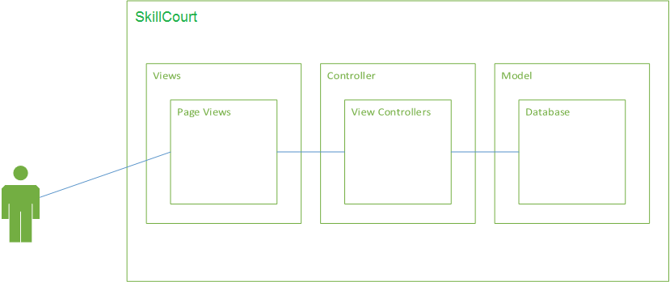
System Design: Architecture
Notes:
5. System design:
5.1. System decomposition; identify the architecture patterns used (one slide).
5.2. System deployment – h/w and s/w requirements (one slide).
5.3. Persistent data design (one slide).
5.4. Security/Privacy (one slide).

Slide 9
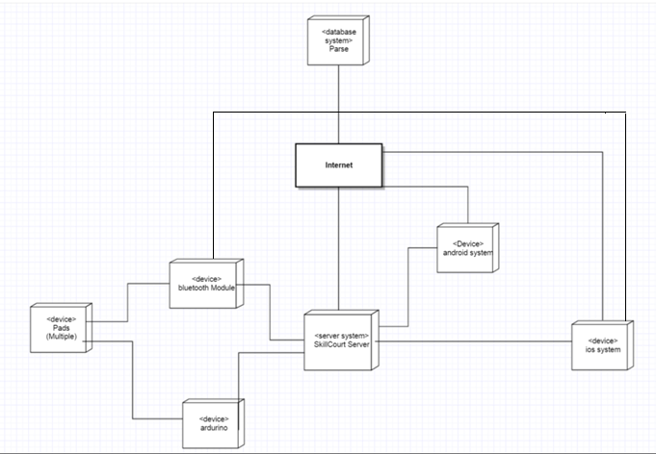
System Design: Deployment
Notes:
5. System design:
5.1. System decomposition; identify the architecture patterns used (one slide).
5.2. System deployment – h/w and s/w requirements (one slide).
5.3. Persistent data design (one slide).
5.4. Security/Privacy (one slide).

Slide 10
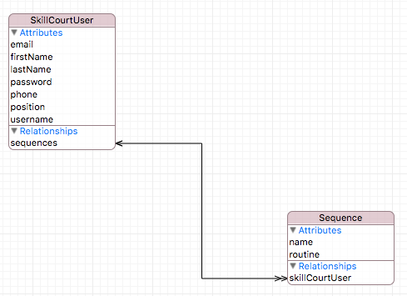
System Design
Persistent data design
Notes:
5. System design:
5.1. System decomposition; identify the architecture patterns used (one slide).
5.2. System deployment – h/w and s/w requirements (one slide).
5.3. Persistent data design (one slide).
5.4. Security/Privacy (one slide).

Slide 11
System Design
Security/Privacy
Since iOS 5, Core Data persistent stores have used Data Protection to encrypt data by default. From the iOS 5.0 release notes:
For apps built for iOS 5.0 or later, persistent stores now store data by default in an encrypted format on disk. You can change the protection level by assigning a custom value to the NSPersistentStoreFileProtectionKey key when configuring your persistent stores.

Slide 12
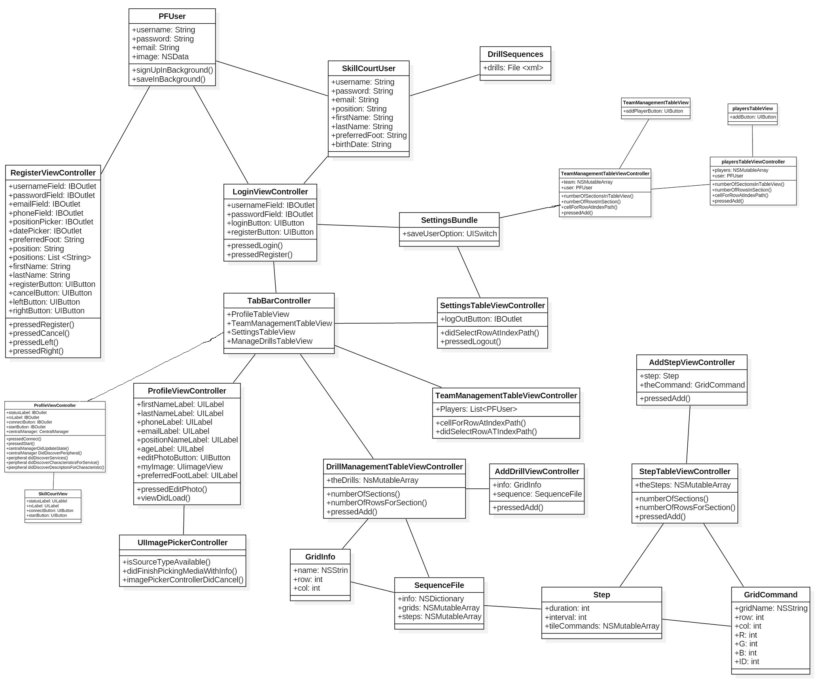
Minimal Class Diagram
The iOS implementation uses a Model – View – Controller (MVC) design pattern
Notes:
6. Detailed design:
6.1. Minimal class diagram. Identify the design patterns used (one or more slides).
6.2. State machine for the main control object or the most important object of the implemented uses cases (one or more slides).
6.3. Main algorithm used related to an implemented use case described above (one or more slides).

Slide 13
Main algorithm
Coredata uses a managed object context to help change data in your model.
return [(AppDelegate*)[[UIApplication sharedApplication] delegate] managedObjectContext];
using the UIApplication class to find the sharedApplication
ask for its delegate
cast it as AppDelegate
call the managedObject context and return it
Notes:
6. Detailed design:
6.1. Minimal class diagram. Identify the design patterns used (one or more slides).
6.2. State machine for the main control object or the most important object of the implemented uses cases (one or more slides).
6.3. Main algorithm used related to an implemented use case described above (one or more slides).

Slide 14
Test Suites and Test Cases
Type | ID | Purpose | result
sunny | SkillCourt-unit-login-001 | Test if login valid with correct info | pass
rainy | SkillCourt-unit-login-002 | Test if login is invalid with incorrect info | pass
rainy | SkillCourt-unit-login-003 | Test if login is invalid with blank info | pass
sunny | SkillCourt-unit-register-004 | Test if registered user is saved to database | pass
sunny | SkillCourt-unit-register-005 | Test if image is saved to database | pass
sunny | SkillCourt-unit-register-006 | Test if current user is save as persistent data | pass
rainy | SkillCourt-unit-register-007 | Test if data storing can handle empty picture input | pass
Notes:
7. Test Suites and Test Cases (one sunny day and one rainy day) for the use case represented in part (5) above (2 slides).
7.1 One sunny day and one rainy day for the implemented use cases (one or more slides).
7.2 Automated test scripts for the implemented use cases (one or more slides).

Slide 15
Test Suites and Test Cases
SkillCourt.RegisterViewController.m
Sunny
ID | SkillCourt-unit-register-004
purpose | Test if registered user is saved to database
precondition | User must input valid credentials Username: sdolc001 Password: 12345 A PFUser object called user must be created with info from registerView Call the save method to database
input | PFQuery for user with username sdolc001
Expected output | PFUser object with Username: sdolc001 Password: 12345

Slide 16
in this project, I implemented the entire iOS application which includes all views persistent data storage, database storage and more an iOS device can now perform many necessary processes for SkillCourt to operate properly.
Questions?
Thank You!
Sebastien Dolce
CS Student
sdolc001@fiu.edu
School of Computing and Information Sciences Florida International University
Notes:
Summarize your contribution
Include your contact information
Ask if anyone has any questions for you.
Thank your audience

